Slide 1
Prediction of fish weight by using a Linear Regression Model
Christian Riccio P37000002
Statistical Data Analisys Project
Mod. A
17/12/2019

Slide 2
OVERVIEW ABOUT THE WORK
Statistical Question
Descriptive Analysis
Explorative Analysis
Inference on the data

Slide 3
STATISTICAL QUESTION
Is it possible to estimate the weight of a fish without measuring it?
The answer should be found among:
Analysis of the physical dimensions
Correlation between variables
Validation of a model

Slide 4
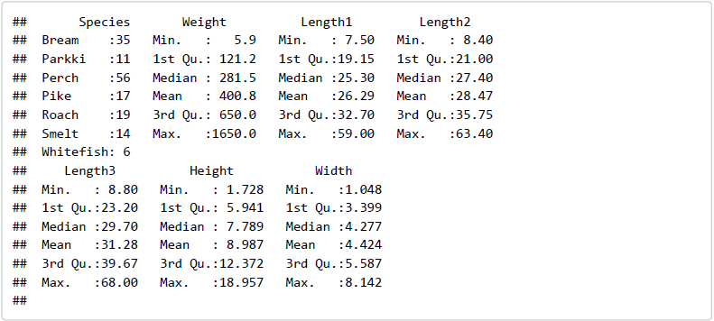
DATASET OVERVIEW
159 observations
7 different fish species
6 quantitative variables
Fig.1- Overview of the dataframe. Data has been downloaded from www.Kaggle.com.

Slide 5
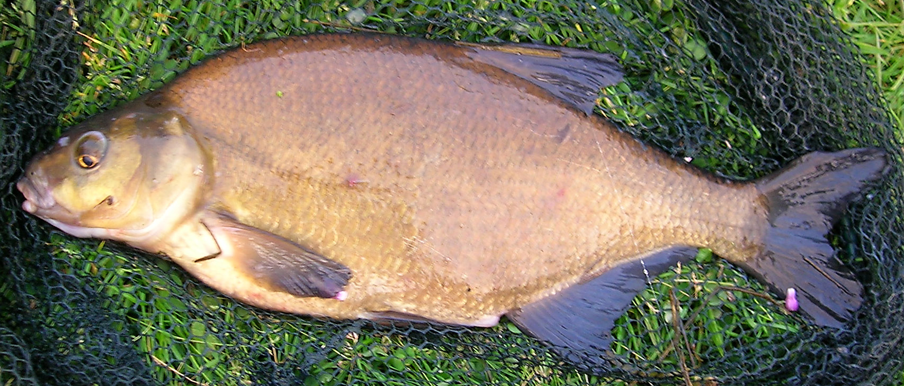
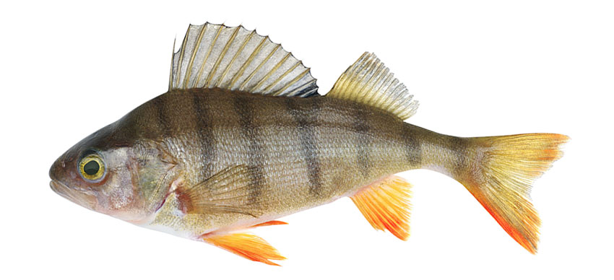

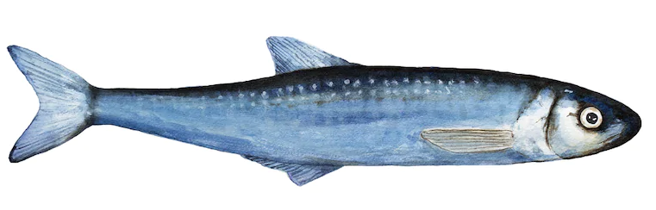
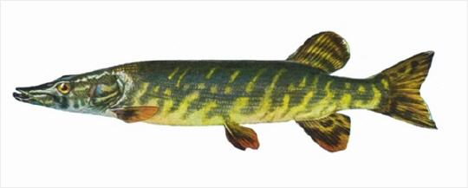
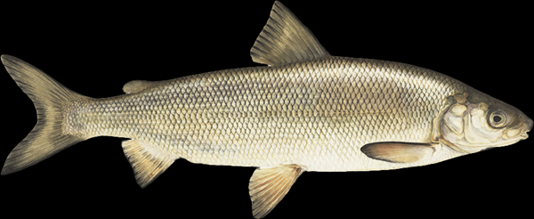
ROACH
BREAM
PERCH
SMELT
PIKE
WHITEFISH

Slide 6
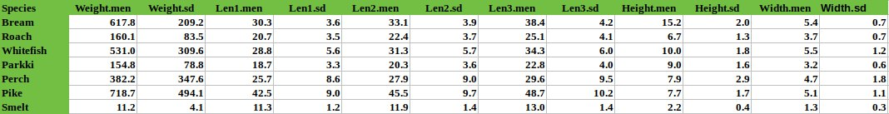
Principal Statistical Indexes
Tab.1- Mean and standard deviation of the variables caracherizating the dataset.

Slide 7
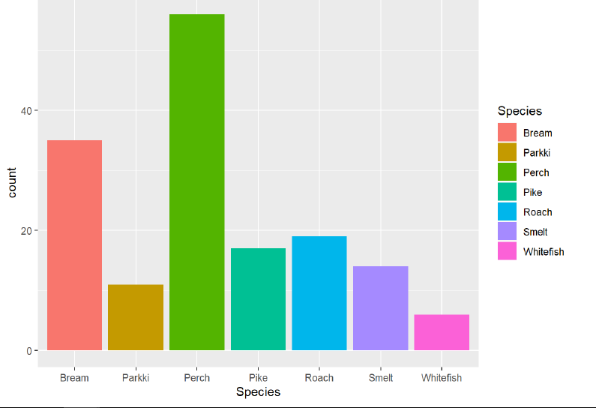
Perch
Bream
Fig.2- Numerosity of the species.

Slide 8
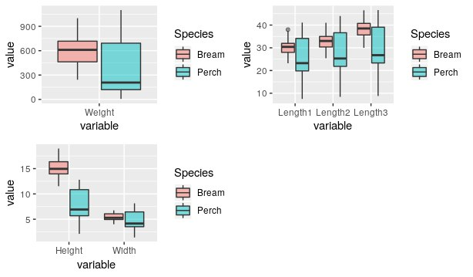
Looking for anomalous values…..
Symmetry
Mean
Median
Fig.3- Boxplots of the Bream and Perch Species, regarding all the variables.

Slide 9
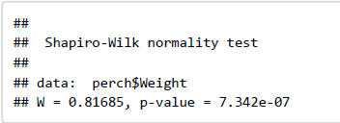
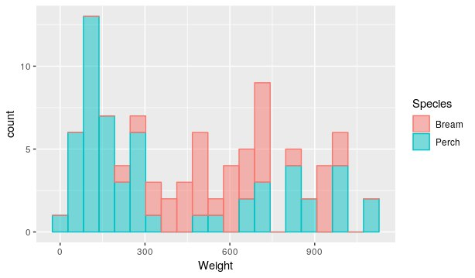
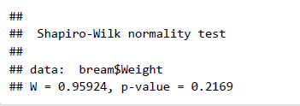
Shapiro-Wilk Normality Test
Box plots examination suggest that the variable does not follow a Gaussian distribution
For the Bream Species we cannot reject the hypoteses H0.
Fig.4- Histogram plot of the weight for the two species.

Slide 10
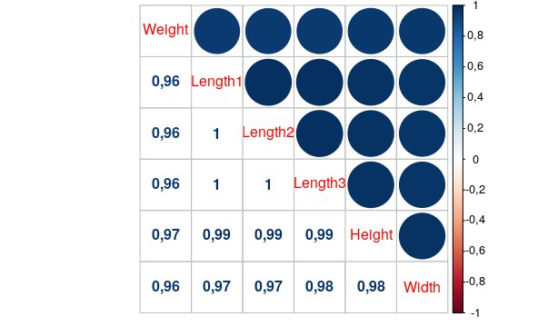
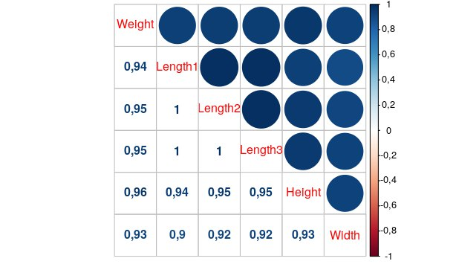
Is the weight correlated with physical dimensions?
Pearson’s Rho coefficient of correlation
PERCH
BREAM
Correlation Matrix
Fig.5-Correlation matrix referred to Perch species.
Fig.6-Correlation matrix referred to Bream species.

Slide 11
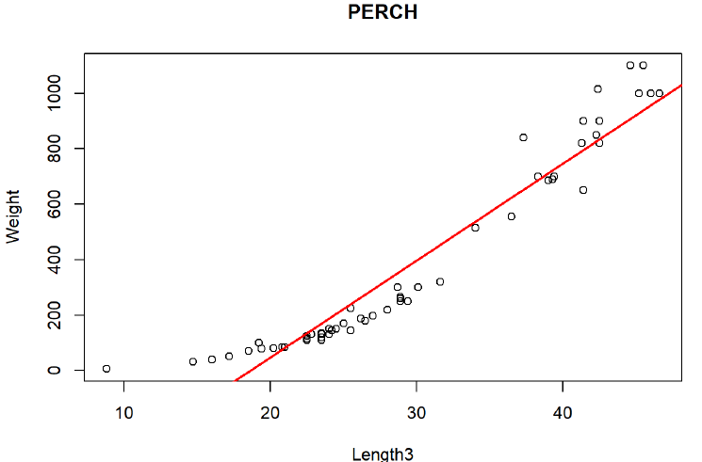
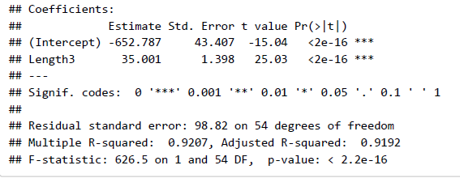
Linear Regression Model
Inferential analysis has been conducted for:
Simple Linear Regression
Multiple Linear Regression
Fig.7-Fit of linear regression for the Perch species.

Slide 12
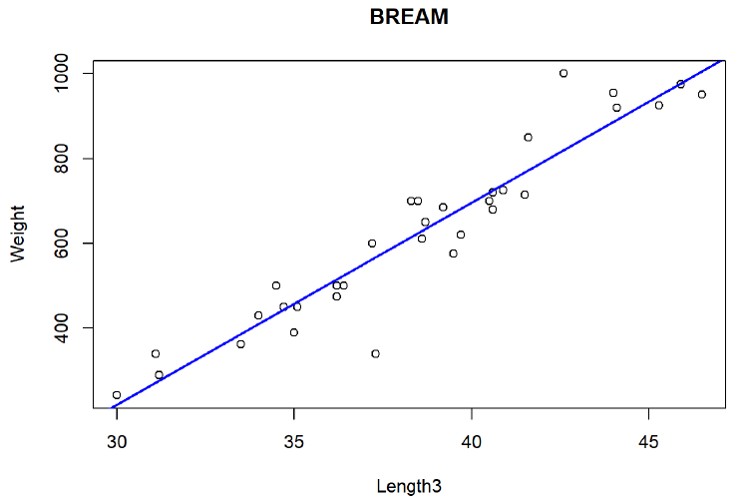
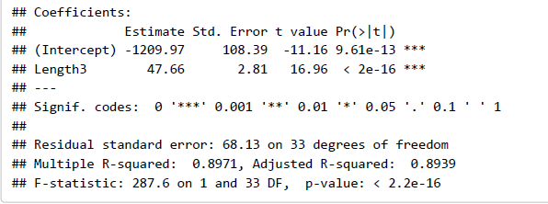
Fig.8-Fit of linear regression for the Bream species.

Slide 13


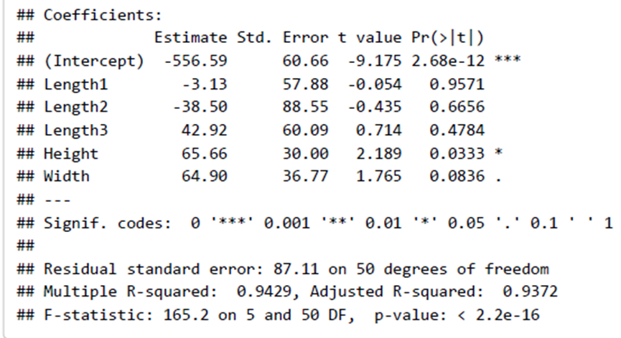
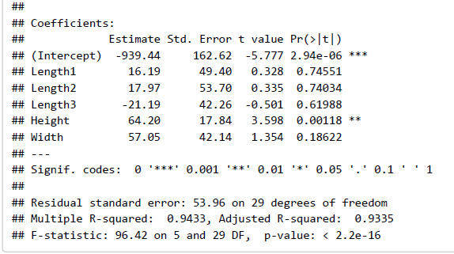
Multiple Linear Regression
PARAMETERS OBTAINED FROM THE MULTIPLE REGRESSION

Slide 14
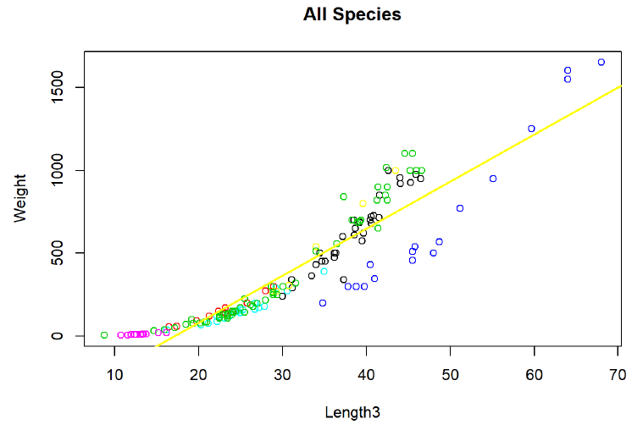
How does the regression model behave with all the Species?
Fig.9-Fit of linear regression for all the species in the dataset.

Slide 15
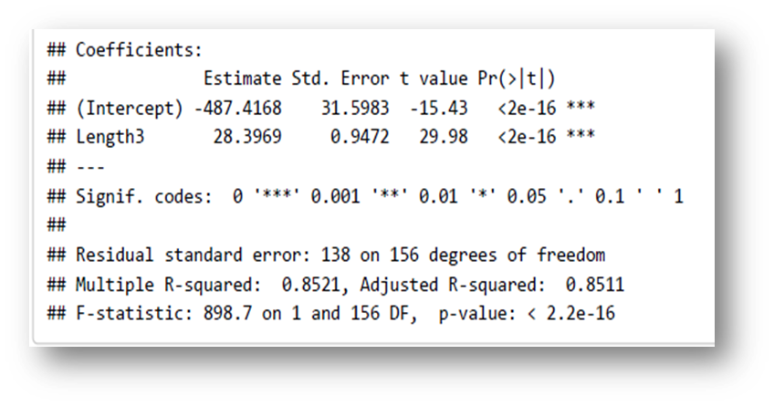
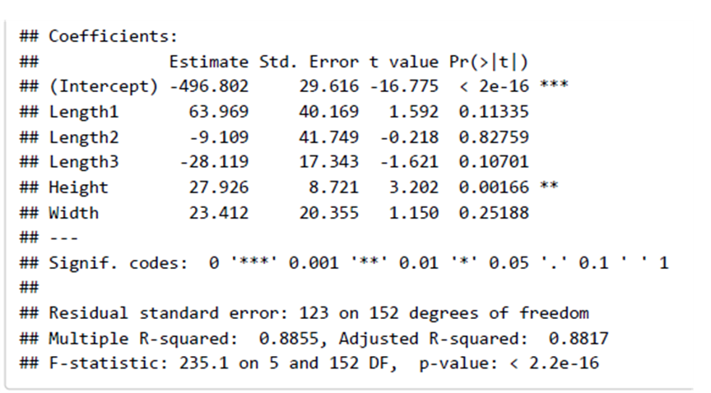
Results of the Linear Regression Model:
Simple Linear Regression
Multiple Linear Regression
Incremented R-squared

Slide 16
CONCLUSIONS
FURTHER DEVELOPMENT
Strong correlation of the weight with all the other variables
It is possibile to predict, explain and then estimate the weight of a fish by using its physical dimensions
Comparison between two models
Since a good value of R-squared does not mean that the model it self is a good predictor for explaining the target variable, a rigorous methodological treatment that follows the foundations of the theory foresees the analysis of the residues, to verify if all the hypotheses necessary for the application of the model are satisfied
Furthermore, could be used a quadratic fit function for modelling the weight

Slide 17
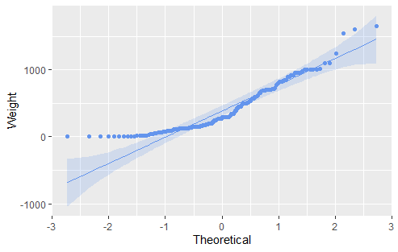
SPOILER…….
Fig.10- Quantile distribution for the weight variable.

Slide 18
THANK YOU FOR YOUR ATTENTION

